Slide 1


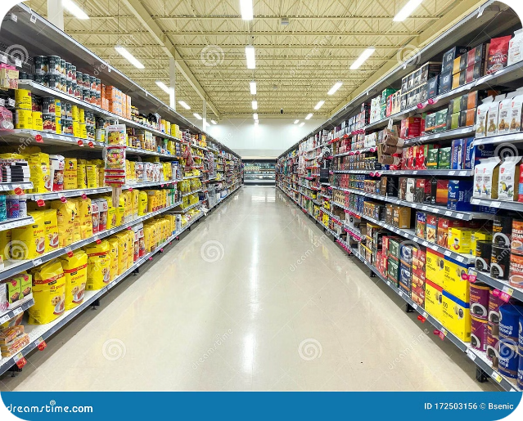


https://www.linkedin.com/in/swapnil-chavan-365950205
BlinkIt Grocery Dataset: Unveiling Retail Insights
The BlinkIt Grocery Dataset offers a comprehensive view of grocery item performance across diverse outlets. This presentation analyzes key trends and patterns in the data, providing valuable insights for data analysts, business intelligence professionals, and retail managers.
by Swapnil Chavan
E = chavanswapnil0990@gmail.com

Slide 2

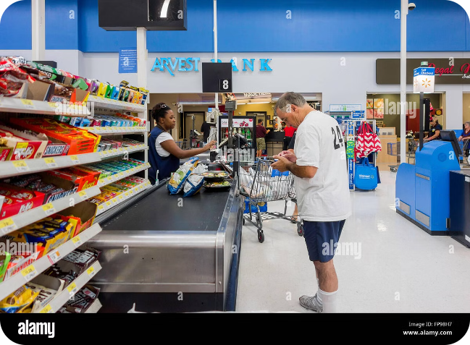
Average Sales Performance
The BlinkIt Grocery Dataset offers a wealth of insights into the sales performance of various items across different retail outlets. One key metric that stands out is the average sales value across all items, which stands at an impressive $140.99. This figure serves as an important baseline, providing a clear understanding of the overall sales performance within the dataset. It offers a point of reference that can be used to compare sales figures across different item categories and outlet types, allowing for a more nuanced analysis of the data. By examining this average sales value, retailers and analysts can gain valuable insights into the general purchasing patterns and behaviors of customers within the grocery industry. This information can then be leveraged to make more informed decisions regarding product selection, pricing strategies, and marketing initiatives, ultimately driving improved sales and profitability..

Slide 3
Item Visibility by Outlet Type
Grocery Stores
Supermarket Type1
Supermarket Type2 & Type3
Item visibility in Grocery Stores is highest, averaging 0.104862. This suggests effective placement strategies and better exposure for items in these outlets.
Supermarket Type1 displays an average item visibility of 0.0607228, slightly lower than Grocery Stores.
Supermarket Type2 and Type3 have similar visibility levels, averaging 0.0610145 and 0.0586147 respectively. These outlets might consider optimizing product placement for greater customer awareness.

Slide 4

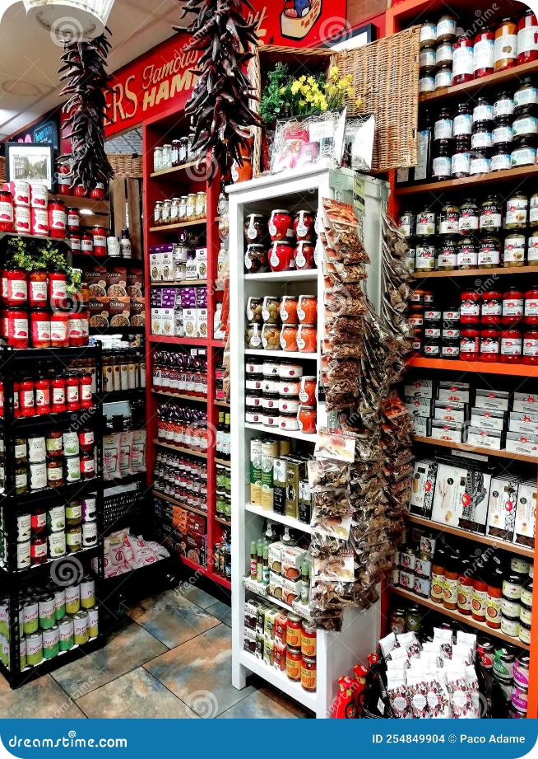
Item Fat Content Distribution
The distribution of item fat content reveals potential trends in customer preference and stocking strategies. This analysis focuses on "Low Fat" and "Regular" categories.
1
High Outlets
High outlets maintain a balanced approach, with similar numbers of "Low Fat" and "Regular" items.
2
Medium Outlets
Medium outlets exhibit a higher proportion of "Low Fat" items compared to "Regular", suggesting potential customer preference for healthier options.
3
Small Outlets
Small outlets primarily stock "Low Fat" items, indicating a strong inclination towards these healthier choices.

Slide 5

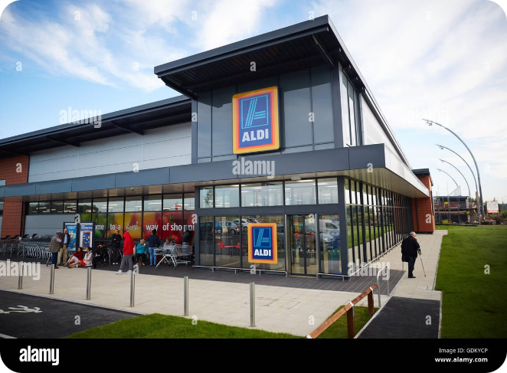
Sales Trends Over Outlet Establishment Years
Analyzing sales trends over outlet establishment years reveals a period of initial growth, followed by a peak and a subsequent decline. This information is crucial for strategic decision-making and identifying potential market shifts.
1
Initial Growth (2011-2016)
Sales exhibited a steady increase, reaching approximately 132,113 by 2016.
2
Peak Year (2018)
Sales peaked in 2018, reaching a total of 204,522.26. This suggests favorable market conditions or promotional activities.
3
Decline Post-Peak (2018-2022)
Sales declined after 2018, stabilizing at lower levels by 2022. Further investigation of market dynamics and external factors is needed.

Slide 6

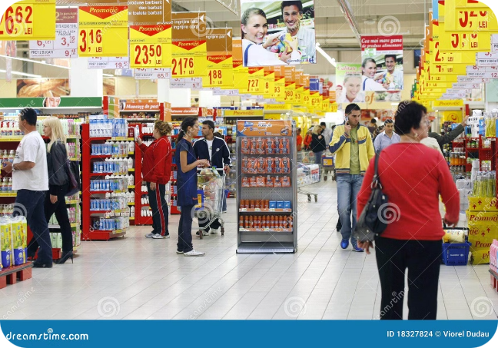
Sales Performance by Outlet Type
Outlet type significantly impacts sales performance. The data reveals clear differences in total sales and average sales per item.
Outlet Type
Total Sales
Average Sales
Grocery Store
151,939
140.295
Supermarket Type1
787,550
141.214
Supermarket Type2
131,478
141.679
Supermarket Type3
130,715
139.802

Slide 7


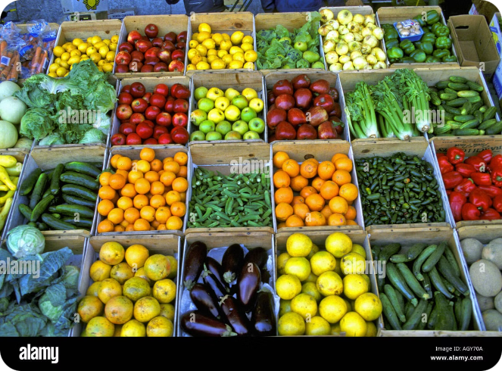



Item Type Frequency Distribution
The dataset contains a diverse range of item types with varying frequencies of occurrence, providing insights into the overall grocery market landscape.
Fruits and Vegetables
The most frequent item type has 1232 occurrences.
Snack Foods
The second most frequent, appearing 1200 times in the dataset.
Household
With a frequency of 910, household items are a significant category.
Frozen Foods
Frozen foods appear 856 times, demonstrating a consistent presence in the grocery market.

Slide 8




Outlet Location Type and Average Rating
Outlet location type influences customer satisfaction, as indicated by average ratings. This analysis focuses on the average rating for each location type.
Tier 1
Tier 1 locations have the highest average rating of 3.97705. This suggests strong customer satisfaction in these areas.
Tier 2 & Tier 3
Tier 2 and Tier 3 locations have slightly lower average ratings, indicating potential areas for improvement in customer experience and service quality.

